Slide 1
Music
Chris Hoorn, Tiffany Pohl, Cody Plungis

Slide 2
Domain Track
Required Courses:
SV 244 Music History: Medieval, Renaissance, Baroque
IA 246 Music Theory I
MUS 113 Music Skills I (Indiana State University course)
MUS 150 Introduction to Musical Traditions I (Indiana State University course)
No longer a suggested domain track
Notes:
Sources: http://www.rose-hulman.edu/Catalog1011/program-se.html
Time: 0:20
Cody

Slide 3
What is Music Software?
Music Recognition Software
Recording Software
Sampling Software
Audio Editing Software
Notation Software
DJ Software
Tuners
Notes:
Sources: http://www.music-software-reviews.com/index.html
Time: 2:00
Cody

Slide 4
Define Quality
Differs depending on the product
Usability
Efficiency
Correctness
Testability
Flexibility
Reliability
Notes:
Sources: http://www.musicmall-asia.com/minni/Papers/costam99jtlm.pdf
Time: 2:00
Cody

Slide 5
Quality Attributes
Recognition Software
Success Rate
Large Library
Recording, Writing, and Editing Software
Attractive Interface
Arrangement of menus and buttons
Representation of Music
Easy to Use
Single click actions
Helpful Labels
Large Feature List
Accurate Emulation of Music
Sound Quality
Sampling Rate
Notes:
Sources: http://www.music-software-reviews.com/index.html, ttp://www.musicmall-asia.com/minni/Papers/costam99jtlm.pdf
Time: 2:00
Cody

Slide 6
Determining Quality
Done through rigorous testing
Technical Testing
Audio Timing
MIDI Timing
Load Testing
Handling and Feature Tests
Setup
Recording
Arrangement
Automation
File Handling
Libraries
Intelligence and Ease
Notes:
Sources: http://www.music-software-reviews.com/recording_software_tests.html
Time: 3:00
Tiffany
Audio Timing – All recording system has some delay. Insignificant in analog domain, different story in digital world, problem also called latency Use audio timing to determine how much of a delay.
Midi Timing – Is not as exact as audio tracks. Delays of 1ms and up can be a problem for percussive signals.
Load Testing – How many tracks can the software handle simultaneously?
Setup – Does everything work? How easy is it to use and understand?
Recording – How many steps / clicks does it take to record something? Are there any features that might be needed (cycle, loop)
Arrangement – How does the cutting audio work? Is it precise? Is there overlap?
Automation – How easily can things be automated? (Things such as volume, fade, jump in track, record, etc)
File Handling – Where are files stored and how secure are they? Can they easily be names and moved? Importing and Exporting.
Libraries – Are there a wide range of templates available?
Intelligence and Ease – Is it easy to build songs? Is it possible to create your own styles?

Slide 7
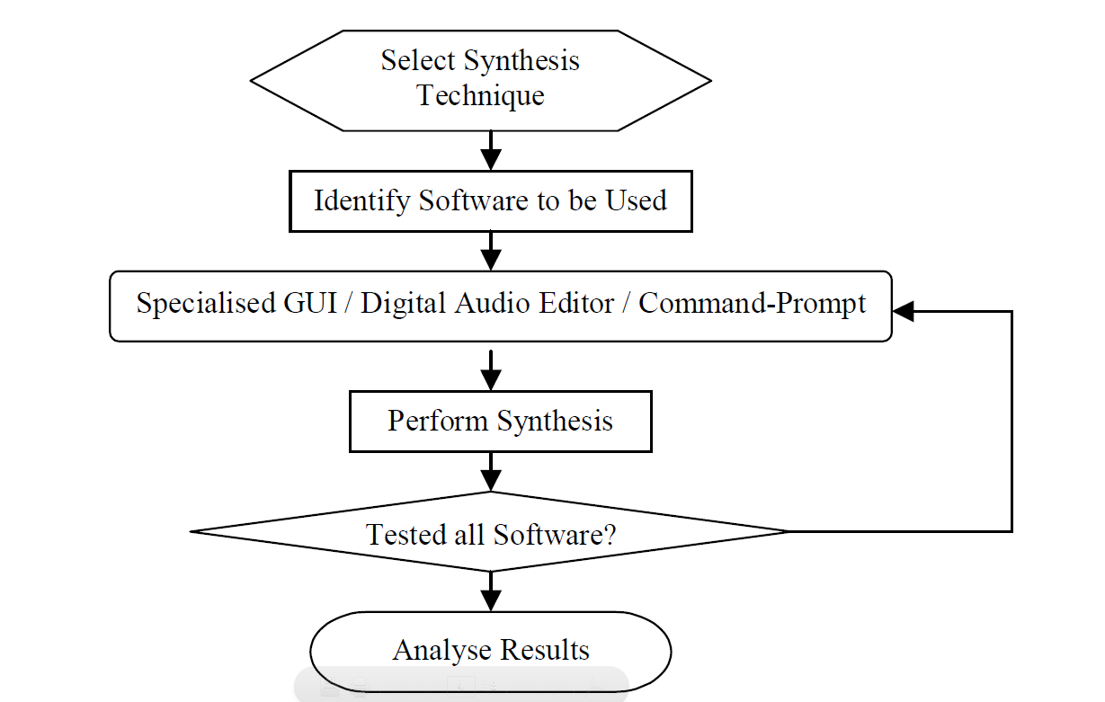
Testing Cycle
Notes:
Sources: http://www.musicmall-asia.com/minni/Papers/costam99jtlm.pdf
Time: 0:20
Tiffany
Basic testing cycle for music software.
What type of editing are you wanting to do? Determine software that would be ideal for this.
Identify type of wave and frequency.

Slide 8
Metrics
Usability
Menu Levels, Shortcut Keys, and Functions
Tutorials, Help Files, and Web Support
Efficiency
Processing Time
Memory Usage
Testability
Questionnaires & Surveys
Flexibility
Customizing Parameters
Supported Formats
Reliability
Sampling Rate
Correctness
Bugs and Error Logs
Notes:
Sources: http://www.musicmall-asia.com/minni/Papers/costam99jtlm.pdf
Time: 1:00
Tiffany
I’m just going to go off of this slide. There is a lot of information here that could easily take a minute to cover.

Slide 9
Suggested Processes
Testing as a developer practice
Involve musicians in design process
Balance Form and Functionality
Tailor the product to the user
Notes:
Sources: Me
Time: 1:00
Tiffany
1.) Developers should be testing everything throughout the development process.
2.) Involving musicians will help achieve what the customers want. It will also help with the quality of playback.
3.) Provide all needed functionality while keeping the interface in an easy to use state.
4.) Make sure the product is easy to use, not all people using it will be super technical.

Slide 10
Suggested Metrics
Options/Menu
Features/Unit Area of GUI
Scaling Factor
Actions/Feature
Quality deterioration over number of copies/edits
Memory use per instrument or per second of data
Reliable range
Simultaneous sampling rates
Sounds/Sample
Notes:
Sources: Me
Time: 2:00
Chris

Slide 11
Industry Successes
Music Recognition Software
Shazam
Notation Software
Finale and Sibelius
Recording Software
Pro-Tools by Digidesign
Sampling Software
Gigasampler/Gigastudio
Editing Software
Sony’s Sound Forge
DJ Software
MaxVibes
Notes:
Sources: http://www.music-software-reviews.com/index.html, http://www.quora.com/Music-Recognition/What-are-the-best-music-recognition-technologies-products-or-services
Time: 1:00
Chris

Slide 12

Industry Failures
Notes:
Sources: http://www.pcworld.com/article/158300/microsoft_songsmith_bad_music_made_easy.html
Time: 2:00
Chris

Slide 13
Songsmith + Roxanne
Notes:
Sources: http://www.youtube.com/watch?v=xWYwY8GpuO0
Time: 0:30
Chris

Slide 14
Industry Standards
Audio Engineering Society (AES)
Notes:
Sources: http://www.aes.org/
Time: 1:00
Chris

Slide 15
QA Issues
Musical quality can be very subjective
Quality Assurance requires a diverse team
Quality is very dependent on hardware
Form vs. Function
Notes:
Sources: Me
Time: 1:00
Chris

Slide 16
Questions?
Notes:
Sources: Me
Time: 1:00

